Slide 1
Operating System
SJF (Shortest Job First)
2. FIFO (First In, First Out)
Manoj C S (4NI19CS066)
Maruthi (4NI19CS067)

Slide 2
SCHEDULING ALGORITHM :
Shortest job first (SJF) or shortest job next, is a scheduling policy that selects the waiting process with the smallest execution time to execute next. SJF is a non-preemptive algorithm.
To successfully implement it, the burst time/duration time of the processes should be known to the processor in advance, which is practically not feasible all the time.
This scheduling algorithm is optimal if all the jobs/processes are available at the same time. (Either Arrival time is 0 for all, or Arrival time is same)

Slide 3
Algorithm :
Sort all the process according to the arrival time.
Then select that process which has minimum arrival time and minimum Burst time.
By the completion of previous process – if set of process has already arrived then select that process among the pool which is having minimum Burst time.

Slide 4
Main function
Header
int main()
{
cout << "Number of Processes: ";
cin >> n; cout << "Process Ids:\n";
for (int i = 0; i < n; i++)
cin >> P[i].id;
cout << "Process Arrival Times:\n";
for (int i = 0; i < n; i++)
cin >> P[i].arrival_time; cout << "Process Burst Times:\n";
for (int i = 0; i < n; i++)
cin >> P[i].burst_time; SJF(); return 0;
}
#include <bits/stdc++.h>
using namespace std;
const int N = 100005;
int n;

Slide 5
Functions
void SJF()
{
int complete, current_time, index, minimum;
double total_waiting_time = 0.0;
double total_turn_around_time = 0.0;
index = -1;
complete = 0;
current_time = 0;
minimum = INT_MAX;
while (complete < n)
{
for (int i = 0; i < n; i++)
{
if (P[i].arrival_time <= current_time)
{
#include <bits/stdc++.h>
using namespace std;
const int N = 100005;
int n;
struct process
{
int id;
int burst_time;
int arrival_time;
int waiting_time;
int finishing_time;
int turn_around_time;
};
process P[N];

Slide 6
Functions
if (P[i].burst_time < minimum && P[i].finishing_time == 0)
{
index = i;
minimum = P[i].burst_time;
}
}
}
if (index >= 0)
{
complete++;
minimum = INT_MAX;
current_time += P[index].burst_time;
P[index].finishing_time = current_time;
P[index].turn_around_time = P[index].finishing_time - P[index].arrival_time;
P[index].waiting_time = P[index].turn_around_time - P[index].burst_time;
total_waiting_time += P[index].waiting_time;
total_turn_around_time += P[index].turn_around_time;
index = -1;
}

Slide 7
else
{
current_time++;
}
}
cout << "id wt "<< " tat " << endl;
for (int i = 0; i < n; i++)7
{
cout << P[i].id << " " << P[i].waiting_time << " " << P[i].turn_around_time << endl;
}
cout << fixed << setprecision(2);
cout << "\nAverage Waiting Time: " << (total_waiting_time / n) << "\n";
cout << "\nAverage Turn Around Time: " << (total_turn_around_time / n) << "\n";
}
Functions

Slide 8
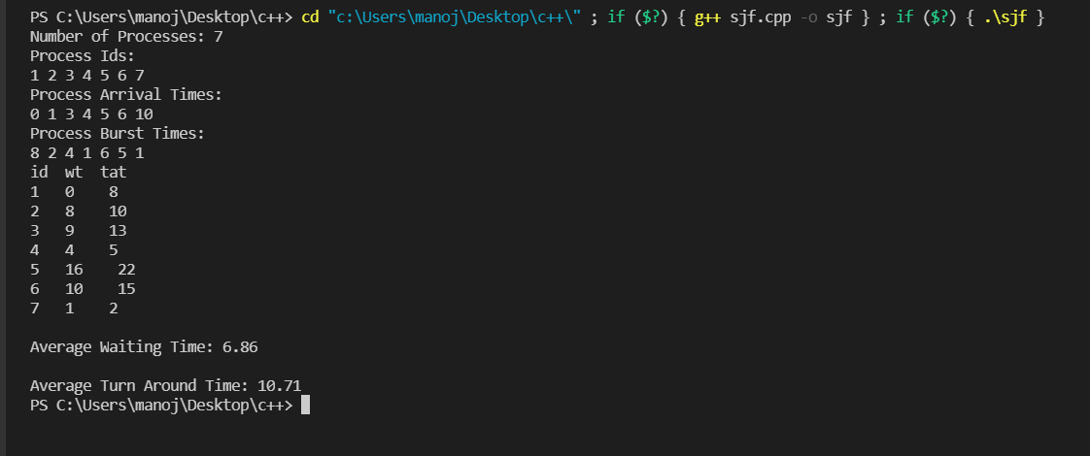

Slide 9
Example:
Input :
Process No: 1 2 3 4 5 6 7
Arrival Time: 0 1 3 4 5 6 10
Burst Time: 8 2 4 1 6 5 1
Output :
Process_No Arrival Time Burst Time Complete_time Turn_Around_Time Wait_Time
1 0 8 8 8 0
2 1 2 11 10 8
4 3 4 16 13 9
3 4 1 9 5 4
5 5 6 27 22 16
6 6 5 21 15 10
7 10 1 12 2 1
Avg Wait Time(WT) is : 10.714
Avg TurnAround Time(TAT) : 6.8581

Slide 10
PAGE REPLACEMENT ALGORITHM:
In operating systems that use paging for memory management, page replacement algorithm are needed to decide which page needed to be replaced when new page comes in.
Whenever a new page is referred and not present in memory, page fault occurs and Operating System replaces one of the existing pages with newly needed page.
Different page replacement algorithms suggest different ways to decide which page to replace. The target for all algorithms is to reduce number of page faults.

Slide 11
Description:
FIFO - This is the simplest page replacement algorithm. In this algorithm, the operating system keeps track of all pages in the memory in a queue, the oldest page is in the front of the queue. When a page needs to be replaced page in the front of the queue is selected for removal.

Slide 12
ADVANTAGES :
> It is simple and easy to understand & implement.
DIS-ADVANTAGES :
>The process effectiveness is low.
>When we increase the number of frames while using FIFO, we are giving more memory to processes. So, page fault should decrease, but here the page faults are increasing. This problem is called as Belady’s Anomaly.

Slide 13
PROGRAM
#include<bits/stdc++.h>
using namespace std; //header file
int main()
{
int i,j,k,n,no,avail;
float fcount=0;
printf("\n ENTER THE NUMBER OF PAGES [reference string length]:\n");
scanf("%d",&n); // total no. of pages in reference string
int ref_str[n+1];
printf("\n ENTER THE REFERENCE STRING :\n");
for(i=1;i<=n;i++) // accept entire reference string
scanf("%d",&ref_str[i]);
printf("\n ENTER THE NUMBER OF FRAMES :");
scanf("%d",&no);
int frame[no];
for(i=0;i<no;i++)
frame[i]= -1; // initialize all page frame to -1

Slide 14
j=0; // initialize page frame pointer
printf("\npage\tpage frames\tHit/Fault\n");
for(i=1;i<=n;i++)
{
printf("%d\t\t",ref_str[i]);
avail=0; // Default value of available flag is 0
for(k=0;k<no;k++)
{
if(frame[k]==ref_str[i]) //input of page request is compared with existing FRAME content
{
avail=1; // as page found available is turned 1
for(k=0;k<no;k++)
printf("%d\t",frame[k]); // Print Current state of FRAME
printf("H"); // Indication of Page Hit
}
}

Slide 15
if (avail==0) // input page requested NOT existing in FRAME
{
frame[j]=ref_str[i]; // place page requested at j th location in FRAME
j=(j+1)%no; // Update J for next Cycle
fcount++; // Increment Counter for Page Fault
for(k=0;k<no;k++)
printf("%d\t",frame[k]); // Print Current state of FRAME
printf("F"); // Indication of Page Fault
}
printf("\n");
}
printf("Page Fault Is %.1f\n",fcount);
cout<<"Hit ratio: "<<((n-fcount)/n)<<"\n";
cout<<"Miss ratio: "<<(fcount/n);
return 0;
}

Slide 16
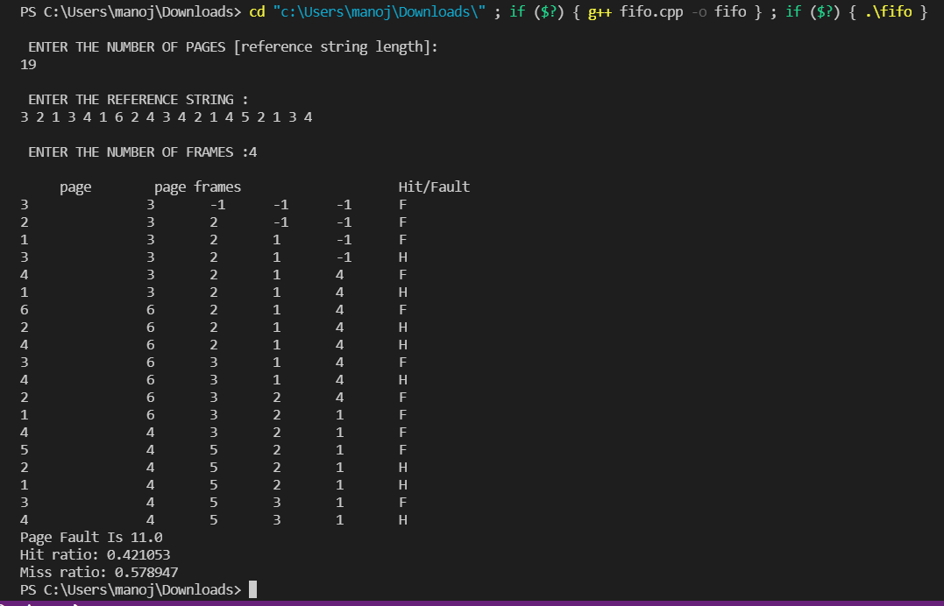
OUTPUT

Slide 17
THANK YOU

